Slide 1

A Hybrid Approach for Detecting Cyberbullying on Social Media Platform using Deep Learning Algorithms
B410
B410
B410
SRM INSTITUTE OF SCIENCE AND TECHNOLOGY
SCHOOL OF COMPUTING
DEPARTMENT OF COMPUTING TECHNOLOGIES
18CSP109L - MAJOR PROJECT
Batch ID:B415
Gutta Koteswararao, RA1911003010621
B.S.K.Bharadwaj, RA1911033010109
Guide: Dr. Vegesna S M Srinivasavarma,
Research. Asst. Prof., Dept. of CTech, SRMIST

Slide 2
Table of Contents
S.No | Title | Page No.
1 | Abstract | 3
2 | Introduction to project | 4
3 | Motivation | 5
4 | Existing Models | 6
5 | Literature Survey | 7
6 | Proposed Architecture | 12
7 | Proposed Modules | 13
8 | References | 13

Slide 3
ABSTRACT
Cyberbullying is becoming more common on social media platforms. Given the popularity and prevalence of social media by people of all ages, it is very important to protect social media platforms from cyberbullying.
This study focuses on how to identify, understand the comments and detect the cyberbullying. This model presents a hybrid deep learning model, called DEA-RNN, to detect CyberBullying on social media network.

Slide 4
Introduction
Social media applications such as Instagram, twitter, facebook, whatsapp etc have become most used and preferred platforms for interaction between people across the globe. These platforms enable people to communicate in different ways, it also leads to vicious ways.
Our proposed work provides a way in detecting cyberbullying using algorithms such as Random Forests, SVM, RNN etc and evaluate the best possible way in detection.

Slide 5
Motivation
Our aim is to detect cyberbullying on social media platforms. Where we try to find the best way possible of detect bullying in comments, texts by using different deep learning algorithms.
The existing papers focused on classifying only one social media ie twitter. But cyberbullying also do exists in different applications. In this paper we are going to do research on different application.

Slide 6
Existing Models
Most of the research papers that are published on this problem used CNN algorithm for classifying cyberbullying. Where they merely focused on image classification on the social media posts.
Our model focuses on bullying that undergoes in inner sections of social media platforms such as groups, comment sections. Where most of unnoticed cyberbullying takes place.

Slide 7
Literature Survey
Serial Number | Title | Authors | Year of Publication | Methodology | Conclusion
1) | Detection of Hate Tweets using Machine Learning and Deep Learning | Lida Ketsbaia, Biju Issac, Xiaomin Chen | 2020- IEEE 19th International conference on Trust,Security and Privacy in Computing and Communications | The paper explores machine learning approaches using word embeddings such as Distributed Bag of Words and Distributed Memory Mean and the performance of Word2vec Convolutional Neural Networks (CNNs) to classify online hate. | This paper used several methods for two data sets linear SVC produced highest accuracy and Bernoulli naïve Bayes produced lowest. using continuous bag of words + CNN resulted them an accuracy of 94% and 98.20% of accuracy while integrating CNN + Skipgram

Slide 8
Literature Survey
Serial Number | Title | Authors | Year of Publication | Methodology | Conclusion
2) | DEA-RNN: A Hybrid Deep Learning Approach for Cyberbullying Detection in Twitter Social Media Platform | Belal Abdullah Hezam Murshed, Jemal Abawajy, Suresha Mallappa, Mufeed Ahmed Naji Saif, Hasib Daowd Esmail Al-Ariki | 2022-IEEE Access | The proposed model combines Recurrent Neural Networks with Dolphin Echolocation Algorithm for classifying cyberbullying in tweets | The produced results of this paper show that DEA-RNN was having upper hand in detecting cyberbullying compared to Bi-directional long short term memory, Multinomial Naïve Bayes.

Slide 9
Literature Survey
Serial Number | Title | Authors | Year of Publication | Methodology | Conclusion
3) | Optimized Twitter Cyberbullying Detection based on Deep Learning | Monirah A. Al-Ajlan, Mourad Ykhlef | 2018-21st Saudi Computer Society National Computer Conference | In this paper they proposed an optimised twitter cyberbullying detection based on deep learning(OCDD) using CNN | They explored new detection techniques using training data by human intelligence and word embedding was for each word using Glo Ve technique. CNN was used for classifying. Which gave great results on text mining tasks however not used on cyberbullying detection context.

Slide 10
Literature Survey
Serial Number | Title | Authors | Year of Publication | Methodology | Conclusion
4) | Cyberbullying Detection using Pre-Trained BERT Model | Jaideep Yadav, Devesh Kumar, Dheeraj Chauhan | 2020- International Conference on Electronics and Sustainable Communication Systems(ICESC) | A new Approach is proposed to cyberbullying detection using pre-trained BERT model with a single linear neural network layer on top as classifier | In this approach of using pre-trained BERT model which is based on the complex and novel deep neural network using single linear linear layer of neural network gives better and stable results compared to CNN.

Slide 11
Literature Survey
Serial Number | Title | Authors | Year of Publication | Methodology | Conclusion
5) | Cyberbullying Detection using Recursive Neral Network through offline Repository | Nidhi Chandra, Sunil Kumar Khatri, Subhranil Som | 2018- 7th International Conference on Reliability, Infocom Technologies and Optimization (ICRITO) | This paper proposed a prediction method of the user behaviour on his posts on social networking sites specifically twitter tensorflow apis have been used to predict analysis.NLP is applied to break text and CNN for classifying images. | This experiment presents classifying cyberbullying and cyber trolling. Tensorflow contribution library is used to generate the prediction from data set. And converted training and test set into Numpy array.

Slide 12
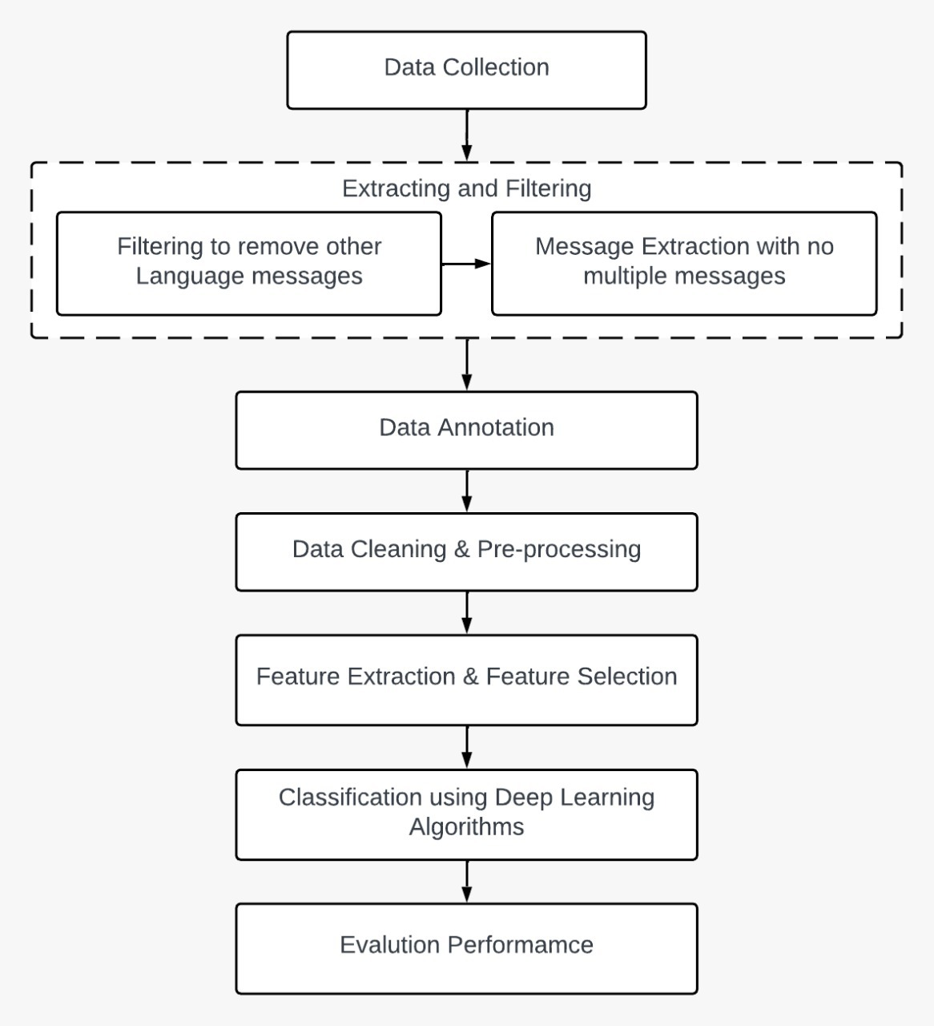
Proposed Architecture
1.1 Architecture

Slide 13
Proposed Modules
Random Forest is a commonly used machine learning algorithm that combines the outputs of multiple decision trees to produce a single result. Its ease of use and flexibility are driving its adoption as it can handle both classification and regression problems.
SVM is one of the most popular supervised learning algorithms used for both classification and regression problems. It is mainly used for machine learning classification problems. It creates the decision boundary that can segregate n-dimensional space into classes so that we can easily put the new data point in the correct category.

Slide 14
Proposed Modules
Recurrent neural network (RNN) is a type of artificial neural network which uses sequential data or time series data. This deep learning algorithm are commonly used for ordinal or temporal problems, such as language translation, Natural Language Processing (NLP), speech recognition.
Dolphin Echolocation Algorithm is mimics strategies used by dolphins for their hunting process. An optimized DEA method is used to reduce the training time for data.

Slide 15
References
Lida Ketsbaia, Biju Issac and Xiaomin Chen, “Detection of Hate Tweets using Machine Learning and Deep Learning,” in Proc. of the 19th IEEE International conference on Trust, Security and Privacy in Computing and Communications, Guangzhou, China, pp. 751-758, 2020.
Belal Abdullah Hezam Murshed, Jemal Abawajy, Suresha Mallappa, Mufeed Ahmed Naji Saif, and Hasib Daowd Esmail Al-Ariki, “DEA-RNN: A Hybrid Deep Learning Approach for Cyberbullying Detection in Twitter Social Media Platform,” IEEE Access, vol. 10, no. , pp. 25857-25871, 2022.
Monirah A. Al-Ajlan, and Mourad Ykhlef, “Optimized Twitter Cyberbullying Detection based on Deep Learning,” in Proc. of the 21st Saudi Computer Society National Computer Conference (NCC), Riyadh, Saudi Arabia, pp. 1-5, 2018.
Jaideep Yadav, Devesh Kumar, and Dheeraj Chauhan, “Cyberbullying Detection using Pre-Trained BERT Model,” in Proc. of the International Conference on Electronics and Sustainable Communication Systems (ICESC), Coimbatore, India, pp. 1096-1100, 2020.
Nidhi Chandra, Sunil Kumar Khatri, and Subhranil Som, “Cyberbullying Detection using Recursive Neral Network through offline Repository,” in Proc. of the 7th International Conference on Reliability, Infocom Technologies and Optimization (Trends and Future Directions) (ICRITO), Noida, India, pp. 748-754, 2018.

Slide 16
Thank You

